Slide 1
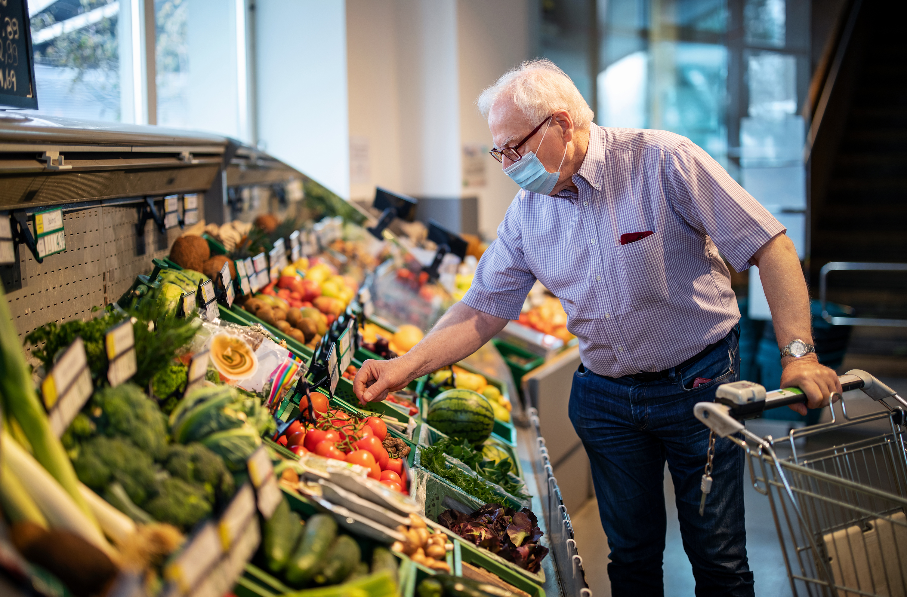

Innovating. Shopping. Experience.
Team Green - Edita, Femke, Jop & Luke

Slide 2


Contents
Concept
Customer journey maps
Prototype
What’s next?

Slide 3
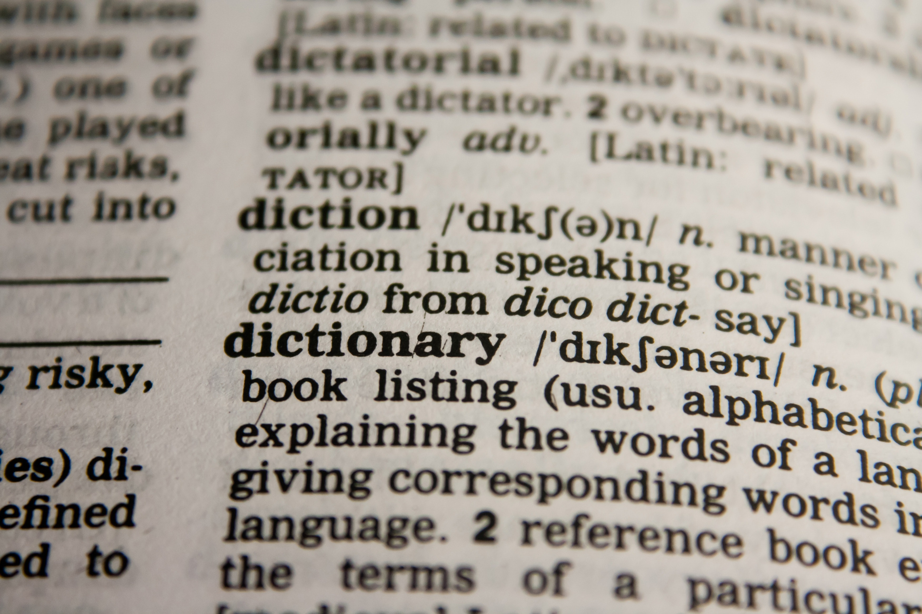

Core concept
Save diet restrictions
Scanning & shopping cart
Help identify 'threatening' ingredients
Recommend alternatives
Fast checkout
Notes:
The core concept is: EXPAND EXISTING SCANNING APP FEATURES

Slide 4

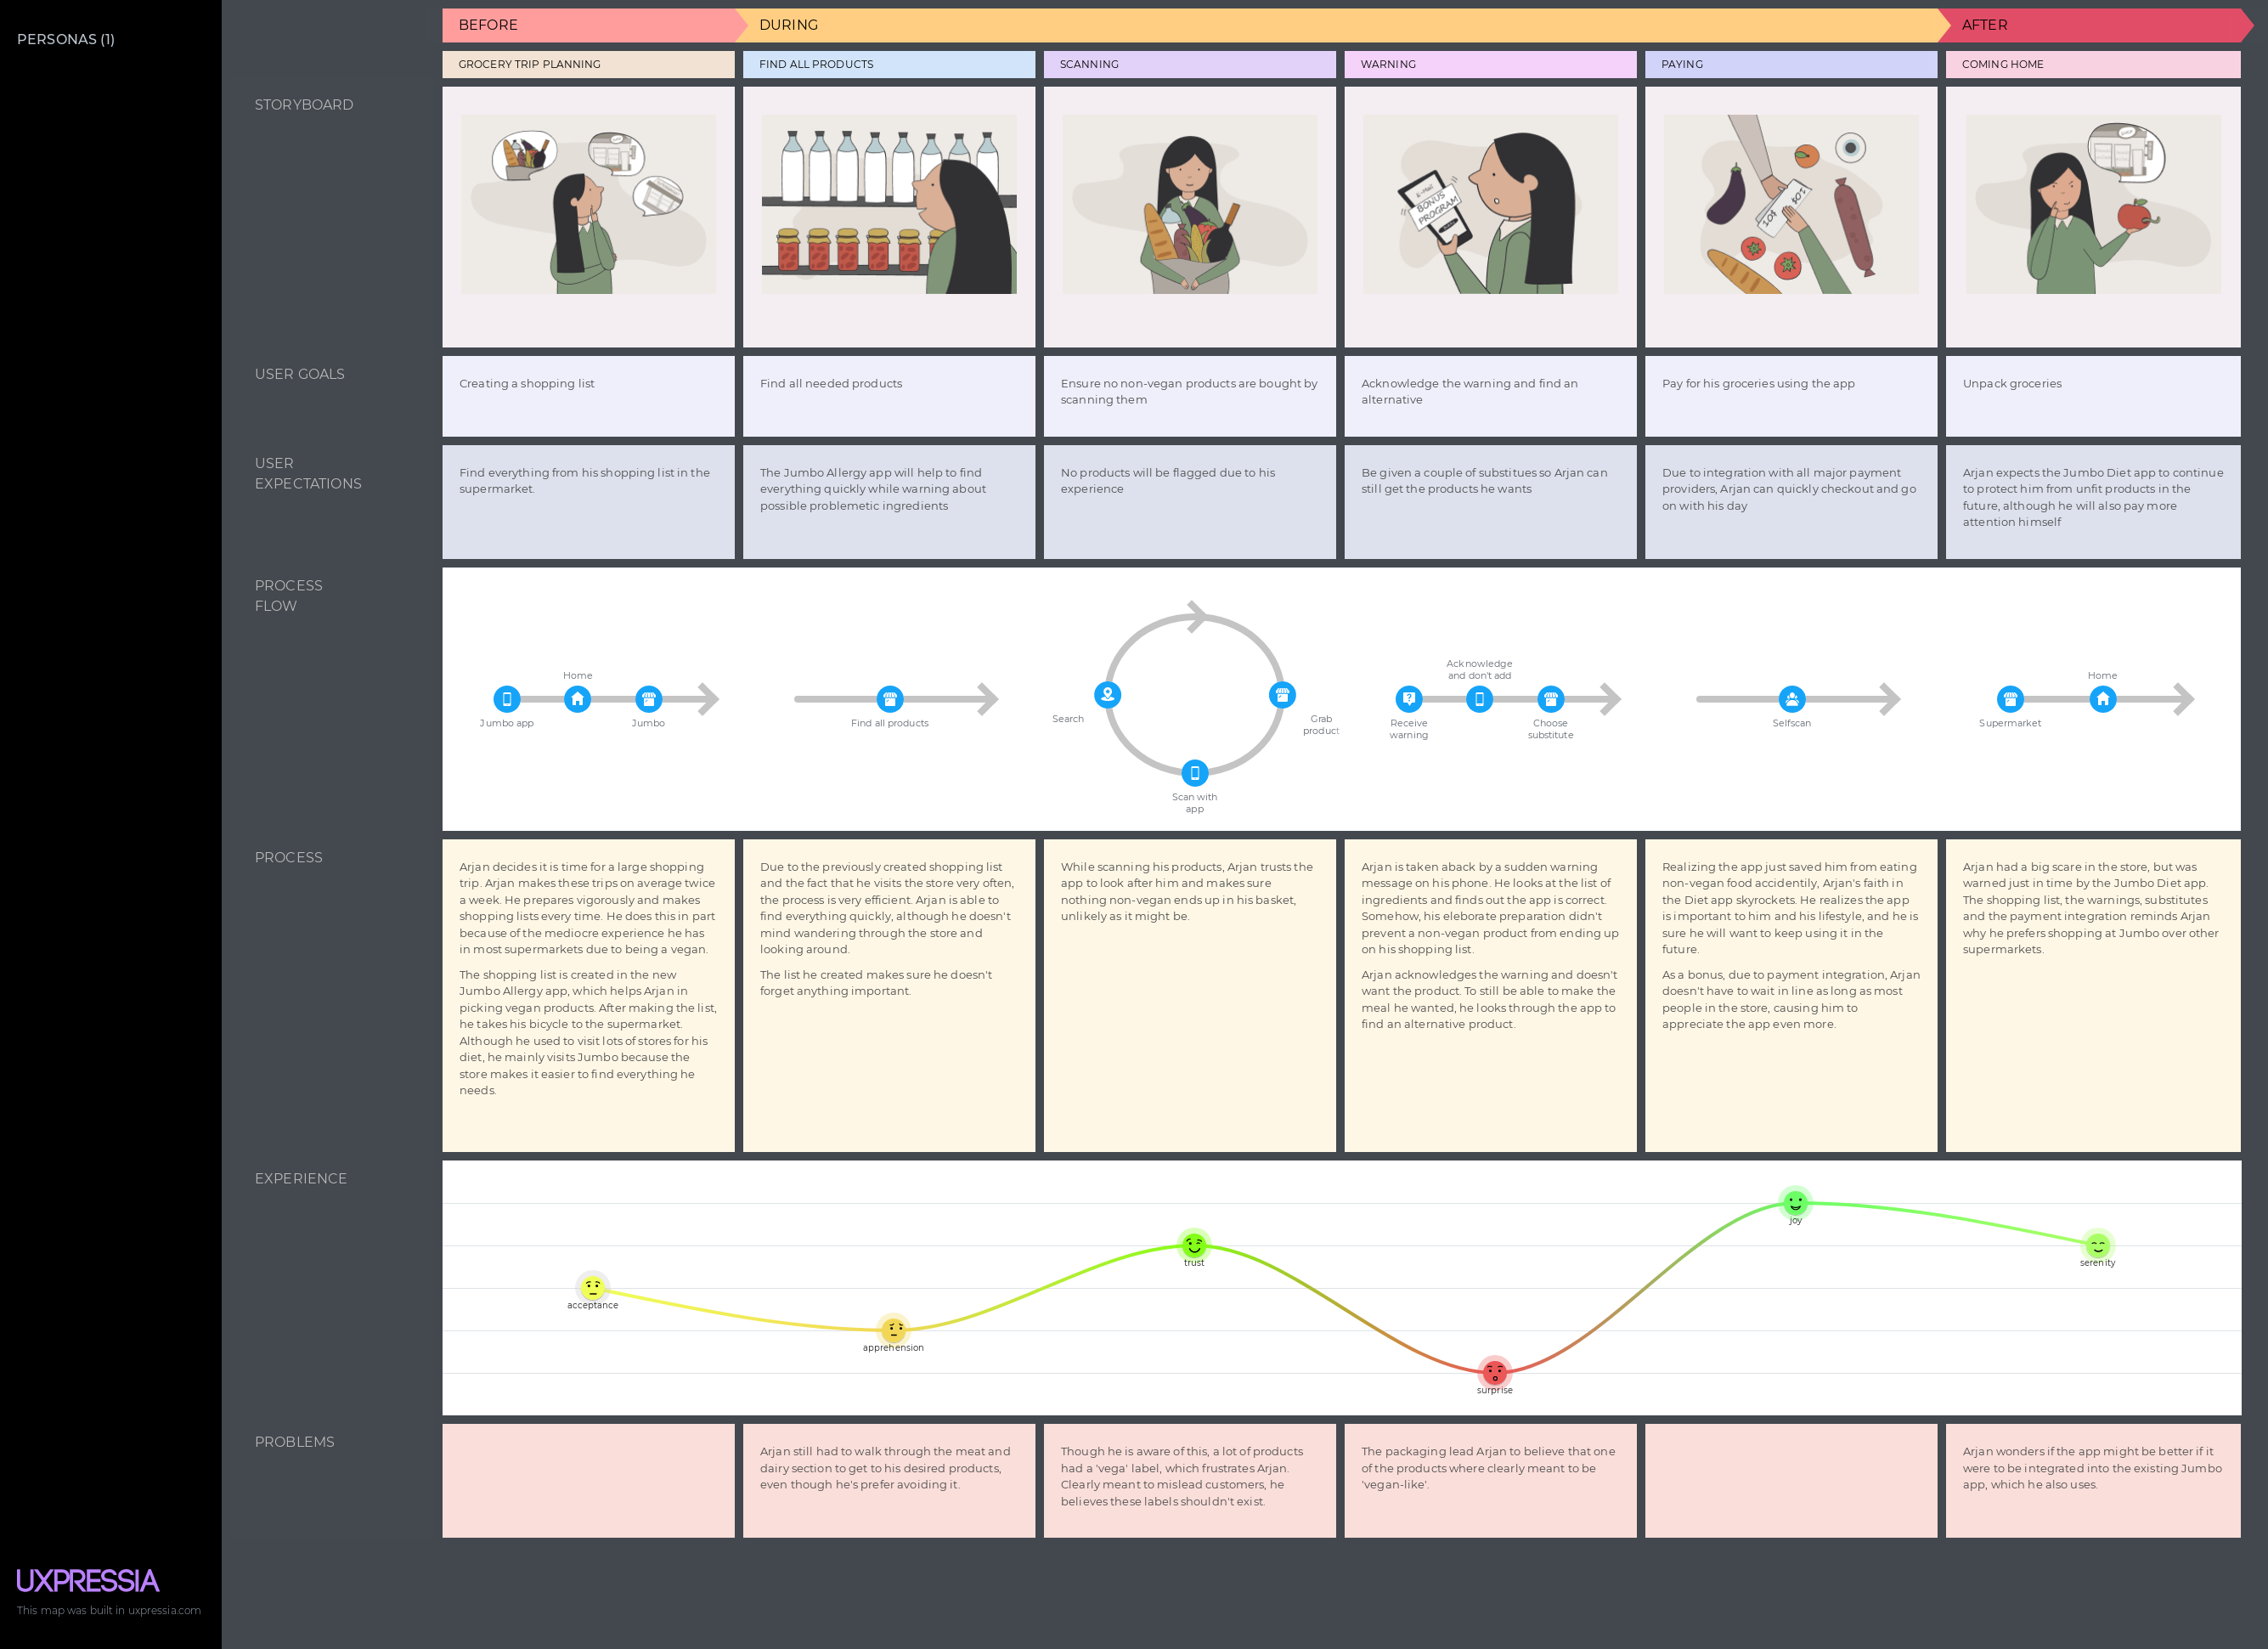
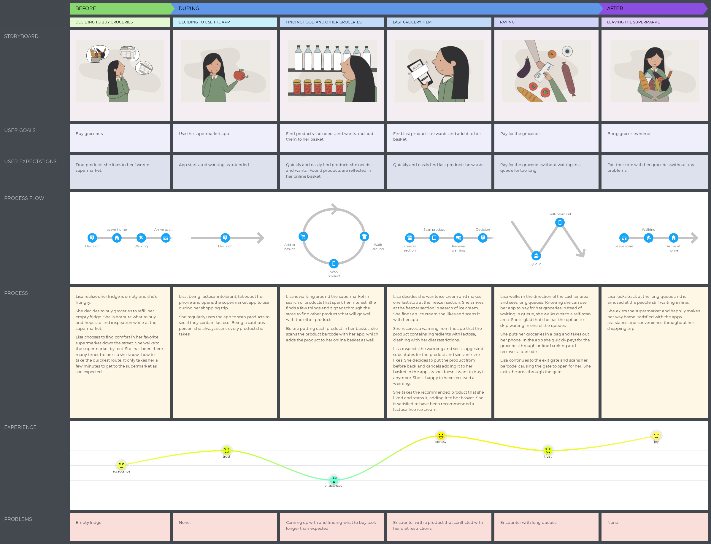
Customer journey maps
Notes:
Filtered features we came up with in the DT Venn Diagram to see which features cover which aspects.
Business, Technology, People
Emotional, Process, Functional
Experience
Wrote down all smartcart functions and categorized them based on if they are good for Jumbo, the customer and technically feasible.
[next slide]

Slide 5


Prototype

Slide 6


What’s Next?
Focus on what people CAN have
Digital prototype
Technical prototype
User testing
Notes:
Technical prototype: includes choosing framework and language

Slide 7

Feedback & Questions

